Slide 1
Towards a Christian View of the World
Sessions 13 and 14
Dr. Lewis Winkler • East Asia School of Theology (Singapore) Uploaded by Dr. Rick Griffith • Jordan Evangelical Theological Seminary Files in many languages for free download at BibleStudyDownloads.org

Slide 2
Introduction

Slide 3
Some Non-negotiable Aspects of a Genuinely Christian View of the World:

Slide 4
Some Non-negotiable Aspects of a Genuinely Christian View of the World:
God exists as a personal and Triune God—Father, Son, and Spirit—who created, sustains, and continues to care for and reveal Himself to everything and everyone (Isaiah 45:20-22; John 16:7-15).

Slide 5
Some Non-negotiable Aspects of a Genuinely Christian View of the World:
God exists as a personal and Triune God—Father, Son, and Spirit—who created, sustains, and continues to care for and reveal Himself to everything and everyone (Isaiah 45:20-22; John 16:7-15).
His Creation:
Real and Good:

Slide 6
Some Non-negotiable Aspects of a Genuinely Christian View of the World:
God exists as a personal and Triune God—Father, Son, and Spirit—who created, sustains, and continues to care for and reveal Himself to everything and everyone (Isaiah 45:20-22; John 16:7-15).
His Creation:
Real and Good:
Ordered and Meaningful:

Slide 7
Some Non-negotiable Aspects of a Genuinely Christian View of the World:
God exists as a personal and Triune God—Father, Son, and Spirit—who created, sustains, and continues to care for and reveal Himself to everything and everyone (Isaiah 45:20-22; John 16:7-15).
His Involvement:
Transcendent (Genesis 1:1; Isaiah 40:12-26):

Slide 8
Some Non-negotiable Aspects of a Genuinely Christian View of the World:
God exists as a personal and Triune God—Father, Son, and Spirit—who created, sustains, and continues to care for and reveal Himself to everything and everyone (Isaiah 45:20-22; John 16:7-15).
His Involvement:
Transcendent (Genesis 1:1; Isaiah 40:12-26):
Immanent (Isaiah 59:1):

Slide 9
Some Non-negotiable Aspects of a Genuinely Christian View of the World:
God exists as a personal and Triune God—Father, Son, and Spirit—who created, sustains, and continues to care for and reveal Himself to everything and everyone (Isaiah 45:20-22; John 16:7-15).
His Involvement:
Transcendent (Genesis 1:1; Isaiah 40:12-26):
Immanent (Isaiah 59:1):
Some Analogies for Understanding:

Slide 10
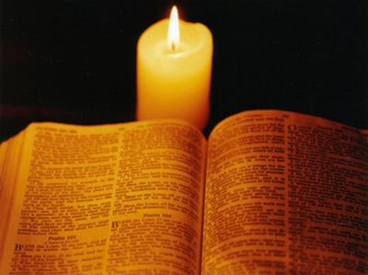
Some Non-negotiable Aspects of a Genuinely Christian View of the World:
The Bible and Jesus Christ are God’s final and definitive revelation to humanity (John 1:14-18; Hebrews 1:1-2).

Slide 11
Some Non-negotiable Aspects of a Genuinely Christian View of the World:
It is within this revelatory framework and storyline that we ultimately find our place in God’s universe.

Slide 12
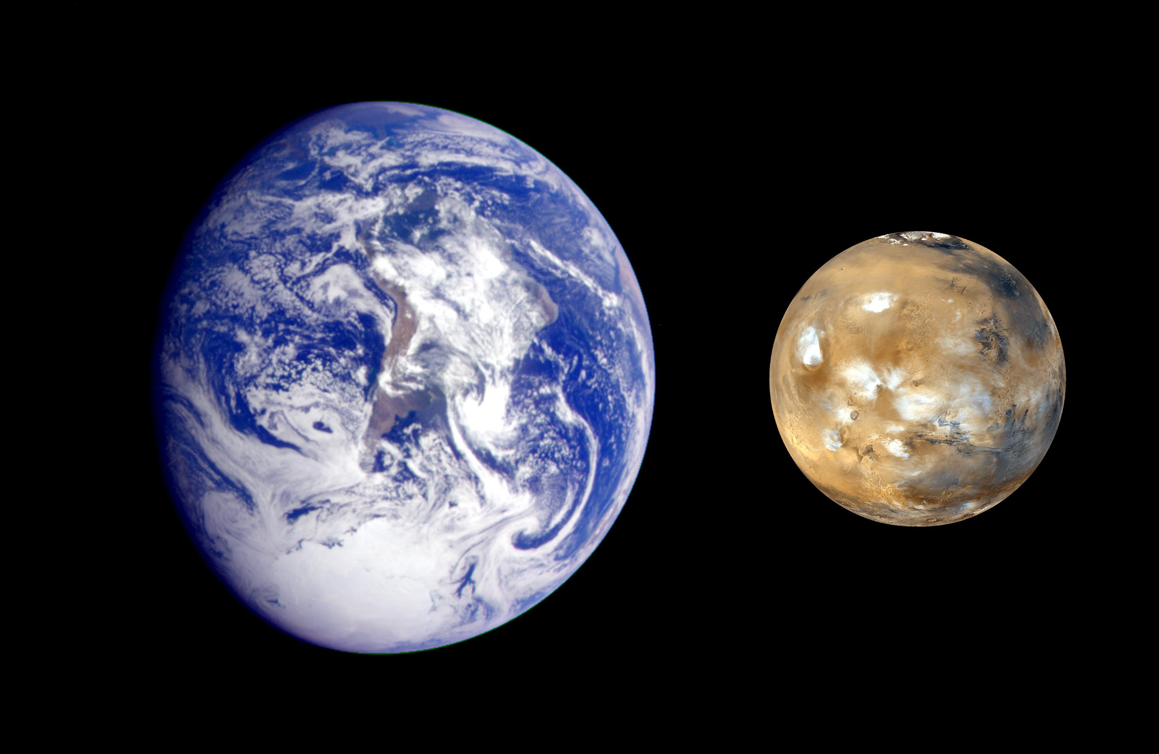
Some Non-negotiable Aspects of a Genuinely Christian View of the World:
It is within this revelatory framework and storyline that we ultimately find our place in God’s universe.
Where are we (Genesis 1; Psalm 104)?

Slide 13
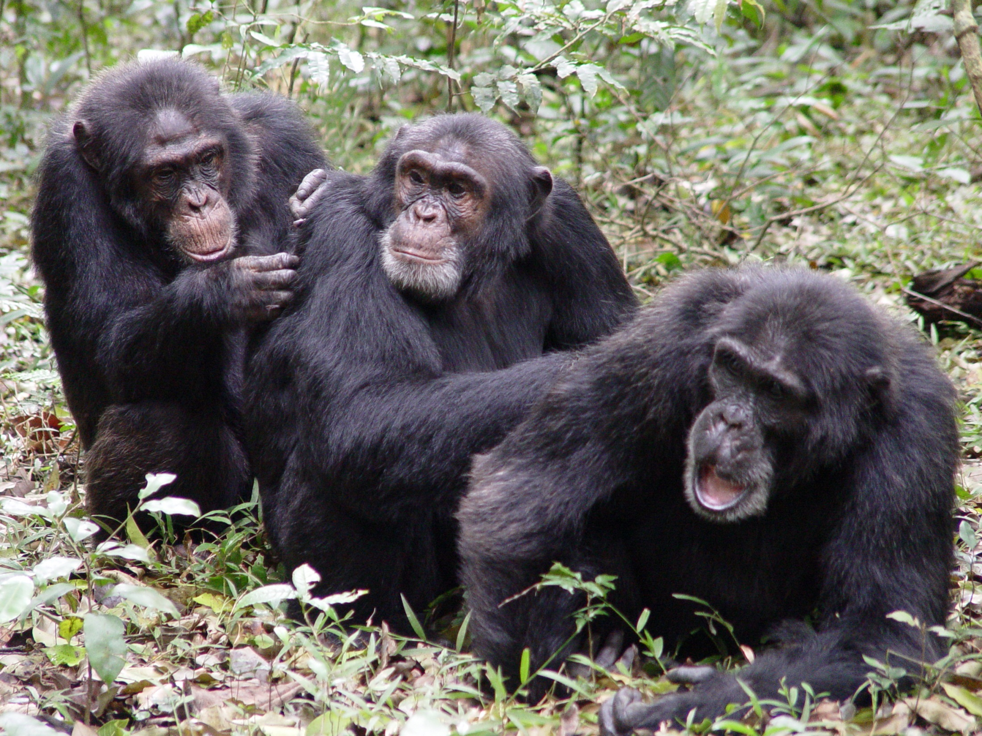
Some Non-negotiable Aspects of a Genuinely Christian View of the World:
It is within this revelatory framework and storyline that we ultimately find our place in God’s universe.
Where are we (Genesis1; Psalm 104)?
Who are we?

Slide 14
Some Non-negotiable Aspects of a Genuinely Christian View of the World:
It is within this revelatory framework and storyline that we ultimately find our place in God’s universe.
Where are we (Genesis 1; Psalm 104)?
Who are we?
Image-bearers of God (Genesis 1:27-28; James 3:9):

Slide 15
Some Non-negotiable Aspects of a Genuinely Christian View of the World:
It is within this revelatory framework and storyline that we ultimately find our place in God’s universe.
Where are we (Genesis 1: Psalm 104)?
Who are we?
Image-bearers of God (Genesis 1:27-28; James 3:9):
Dependent and Finite Beings (Psalm 8:4-5; 100:3):

Slide 16
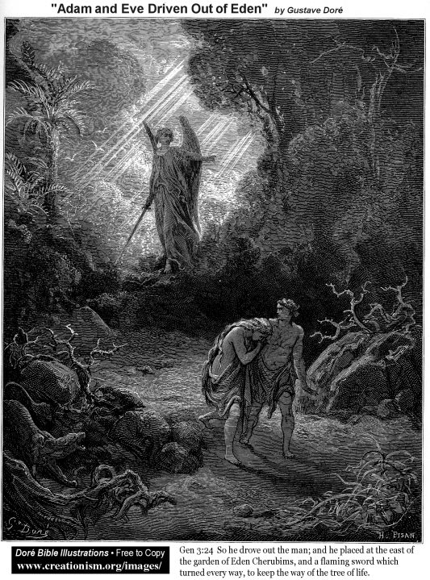
Some Non-negotiable Aspects of a Genuinely Christian View of the World:
It is within this revelatory framework and storyline that we ultimately find our place in God’s universe.
What is wrong?
Some angelic beings and all human beings have rebelled (i.e., sinned) against God (Genesis 3; Romans 3:23).

Slide 17
Some Non-negotiable Aspects of a Genuinely Christian View of the World:
It is within this revelatory framework and storyline that we ultimately find our place in God’s universe.
What is wrong?
While still retaining a vestige of goodness, all creation has been marred and subject to the fallout of rejecting God’s Lordship (Genesis 3; Romans 8).

Slide 18
Some Non-negotiable Aspects of a Genuinely Christian View of the World:
It is within this revelatory framework and storyline that we ultimately find our place in God’s universe.
What is wrong?
All rebels are condemned to death (Romans 6:23; Revelation 20:10).

Slide 19
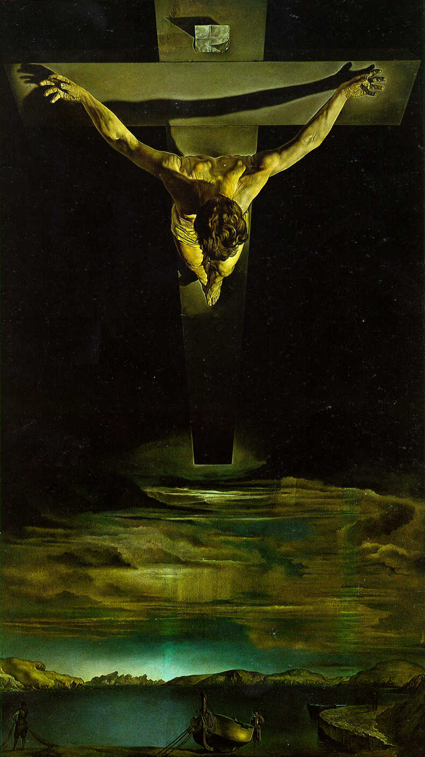
Some Non-negotiable Aspects of a Genuinely Christian View of the World:
It is within this revelatory framework and storyline that we ultimately find our place in God’s universe.
What is the remedy?
Jesus, who is God in the flesh, came to earth to live a perfect and exemplary life, wholly pleasing to God, and to die in our place so we could be restored to intimate fellowship with God, and the rest of creation could ultimately be redeemed for His glory (Romans 8).

Slide 20
Some Non-negotiable Aspects of a Genuinely Christian View of the World:
It is within this revelatory framework and storyline that we ultimately find our place in God’s universe.
What is the remedy?
After He died, Jesus rose from the grave to prove that His life and death were sufficient to forgive our sin, to enable us to have fellowship with God (1 Corinthians 15), and to ultimately redeem creation from the curse of sin.

Slide 21
Some Non-negotiable Aspects of a Genuinely Christian View of the World:
It is within this revelatory framework and storyline that we ultimately find our place in God’s universe.
What is the remedy?
By placing faith in Jesus for forgiveness, everyone can experience God’s forgiveness and join His family. The sufficiency of His sacrifice makes it complete, and we can add nothing to it to save ourselves (Ephesians 2:8-9).

Slide 22
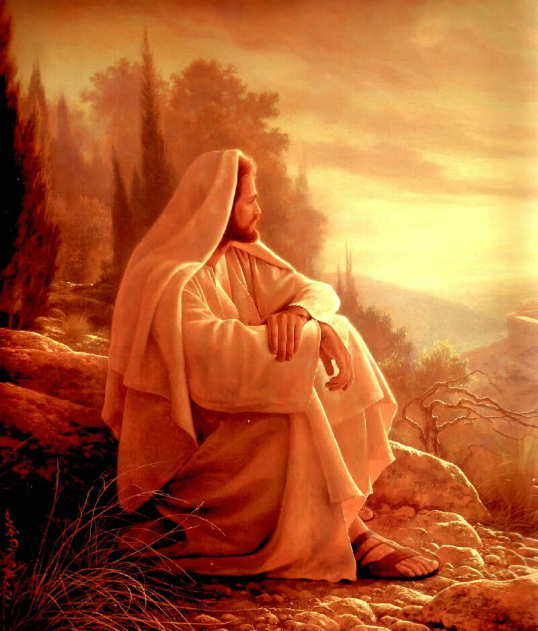
Some Non-negotiable Aspects of a Genuinely Christian View of the World:
It is within this revelatory framework and storyline that we ultimately find our place in God’s universe.
What is the remedy?
Because of His sufficiency for salvation, apart from Jesus, there is no hope or means of salvation (John 14:6; Acts 4:12).

Slide 23
Some Non-negotiable Aspects of a Genuinely Christian View of the World:
It is within this revelatory framework and storyline that we ultimately find our place in God’s universe.
What time is it?
This is our time (Esther 4:14b).

Slide 24
Some Non-negotiable Aspects of a Genuinely Christian View of the World:
It is within this revelatory framework and storyline that we ultimately find our place in God’s universe.
What time is it?
While after Christ’s death and resurrection, it is still prior to His return when God through Christ will finally righteously judge and justly deal with any and all sin. Afterwards, He will inaugurate His ultimate kingdom reign for all eternity within a new heaven and a new earth.

Slide 25
Some Non-negotiable Aspects of a Genuinely Christian View of the World:
It is within this revelatory framework and storyline that we ultimately find our place in God’s universe.
What time is it?
While we wait for this culminating climax to this era of creation, as members of Christ’s body, the church, we are called to be holy ambassadors for God’s kingdom here on earth and live according the truth of His word through the power of the Holy Spirit (2 Corinthians 5:20; Romans 8).

Slide 26
Some Non-negotiable Aspects of a Genuinely Christian View of the World:
It is within this revelatory framework and storyline that we ultimately find our place in God’s universe.
To briefly summarize, then, the biblical story and Christian worldview that we live within is the story of creation, fall, redemption, and consummation.

Slide 27
Toward a Practical Method for Developing a Christian Worldview in Any and Every Time and Place: Translation and Contextualization:

Slide 28
Toward a Practical Method for Developing a Christian Worldview in Any and Every Time and Place: Translation and Contextualization:
The Christian Concept of Translation:

Slide 29
Toward a Practical Method for Developing a Christian Worldview in Any and Every Time and Place: Translation and Contextualization:
The Christian Concept of Translation:
The Pilgrim and the Indigenizing Principles of Translation:

Slide 30
Toward a Practical Method for Developing a Christian Worldview in Any and Every Time and Place: Translation and Contextualization:
The Christian Concept of Translation:
Christianity, Incarnation, and “Infinite Translatability”:

Slide 31
Toward a Practical Method for Developing a Christian Worldview in Any and Every Time and Place: Translation and Contextualization:
The Christian Concept of Translation:
Christianity, Incarnation, and “Infinite Translatability”:
Utterly Consistent with and Intimately Connected to the Main Plot but Uniquely Expressed:

Slide 32
Toward a Practical Method for Developing a Christian Worldview in Any and Every Time and Place: Translation and Contextualization:
The Christian Concept of Translation:
Christianity, Incarnation, and “Infinite Translatability”:
Utterly Consistent with and Intimately Connected to the Main Plot but Uniquely Expressed:
A Symphonic (versus Monophonic) Expression (Revelation 7:9-10):

Slide 33
Toward a Practical Method for Developing a Christian Worldview in Any and Every Time and Place: Translation and Contextualization:
Principles for Contextualizing Christianity into Any Cultural Context:

Slide 34
Toward a Practical Method for Developing a Christian Worldview in Any and Every Time and Place: Translation and Contextualization:
Principles for Contextualizing Christianity into Any Cultural Context:
Important Starting Points:

Slide 35
Toward a Practical Method for Developing a Christian Worldview in Any and Every Time and Place: Translation and Contextualization:
Principles for Contextualizing Christianity into Any Cultural Context:
Important Starting Points:
You must know the culture well enough to discern the culturally ascribed meanings and significance of various cultural practices and beliefs.

Slide 36
There are two great dangers in ignoring the secular mind—not only because, as Calvin said, we miss God’s gifts distributed even to unbelievers in His common grace, but because we are left with no way of knowing the extent to which we ourselves are being shaped, albeit indirectly, by these trends in secular thought. . . . In order to judge our ideas, we must know two things as well as we possibly can: the forces of the world, shaping our thoughts, and the truths of scripture, correcting our thoughts and revealing God and His saving promises to us. Those who do not care to read secular books will be impoverished and will be susceptible to subtle and indirect seduction, while those who do not carefully study scripture will lose their plumb line for judging truth from error, belief from unbelief, right from wrong.
Michael S. Horton, Where in the World Is the Church?, 67

Slide 37
Toward a Practical Method for Developing a Christian Worldview in Any and Every Time and Place: Translation and Contextualization:
Principles for Contextualizing Christianity into Any Cultural Context:
Important Starting Points:
You must know the word of God well enough to know what distinctively Christian beliefs and practices should be promoted and inculcated in the church.

Slide 38
Toward a Practical Method for Developing a Christian Worldview in Any and Every Time and Place: Translation and Contextualization:
Principles for Contextualizing Christianity into Any Cultural Context:
Important Starting Points:
You must know how to take these biblical truths that were culturally expressed in the time of their occurrence/composition and extract them from those contexts in order to develop principles for use in trans-cultural and trans-temporal situations.

Slide 39
Toward a Practical Method for Developing a Christian Worldview in Any and Every Time and Place: Translation and Contextualization:
Principles for Contextualizing Christianity into Any Cultural Context:
Important Starting Points:
Then you must know how to re-express these principles, beliefs and practices in the new culture in a way that embraces the culture in its appropriate expressions while rejecting those norms, beliefs and practices that run counter to biblical ones.

Slide 40
Toward a Practical Method for Developing a Christian Worldview in Any and Every Time and Place: Translation and Contextualization:
Principles for Contextualizing Christianity into Any Cultural Context:
Discern biblical norms versus cultural forms.

Slide 41
Toward a Practical Method for Developing a Christian Worldview in Any and Every Time and Place: Translation and Contextualization:
Principles for Contextualizing Christianity into Any Cultural Context:
Discern biblical norms versus cultural forms.
Discern the difference between culturally “neutral” and spiritually charged beliefs and practices.

Slide 42
Toward a Practical Method for Developing a Christian Worldview in Any and Every Time and Place: Translation and Contextualization:
Principles for Contextualizing Christianity into Any Cultural Context:
Discern biblical norms versus cultural forms.
Discern the difference between culturally “neutral” and spiritually charged beliefs and practices.
Seek both relevance and simplicity without compromise.

Slide 43
Toward a Practical Method for Developing a Christian Worldview in Any and Every Time and Place: Translation and Contextualization:
Principles for Contextualizing Christianity into Any Cultural Context:
Take into account all relevant factors.

Slide 44
Toward a Practical Method for Developing a Christian Worldview in Any and Every Time and Place: Translation and Contextualization:
Principles for Contextualizing Christianity into Any Cultural Context:
Take into account all relevant factors.
Constantly ask for the reasons behind the cultural practice or belief.

Slide 45
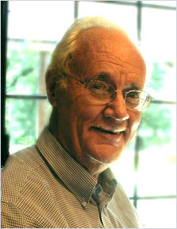
Toward a Practical Method for Developing a Christian Worldview in Any and Every Time and Place: Translation and Contextualization:
Principles for Contextualizing Christianity into Any Cultural Context:
Paul Hiebert’s Guidelines for Critical Contextualization of Local Beliefs and Customs:

Slide 46
Toward a Practical Method for Developing a Christian Worldview in Any and Every Time and Place: Translation and Contextualization:
Principles for Contextualizing Christianity into Any Cultural Context:
Paul Hiebert’s Guidelines for Critical Contextualization of Local Beliefs and Customs:
Adopt:

Slide 47
Toward a Practical Method for Developing a Christian Worldview in Any and Every Time and Place: Translation and Contextualization:
Principles for Contextualizing Christianity into Any Cultural Context:
Paul Hiebert’s Guidelines for Critical Contextualization of Local Beliefs and Customs:
Adopt:
Reject:

Slide 48
Toward a Practical Method for Developing a Christian Worldview in Any and Every Time and Place: Translation and Contextualization:
Principles for Contextualizing Christianity into Any Cultural Context:
Paul Hiebert’s Guidelines for Critical Contextualization of Local Beliefs and Customs:
Substitute:

Slide 49
Toward a Practical Method for Developing a Christian Worldview in Any and Every Time and Place: Translation and Contextualization:
Principles for Contextualizing Christianity into Any Cultural Context:
Paul Hiebert’s Guidelines for Critical Contextualization of Local Beliefs and Customs:
Substitute:
Modify:

Slide 50
Toward a Practical Method for Developing a Christian Worldview in Any and Every Time and Place: Translation and Contextualization:
Principles for Contextualizing Christianity into Any Cultural Context:
Also keep in mind Muck and Adeney’s cross-cultural “Spiral of Knowledge Acquisition.”

Slide 51
Toward a Practical Method for Developing a Christian Worldview in Any and Every Time and Place: Translation and Contextualization:
Principles for Contextualizing Christianity into Any Cultural Context:
Also keep in mind Muck and Adeney’s cross-cultural “Spiral of Knowledge Acquisition.”
Experiencing:

Slide 52
Toward a Practical Method for Developing a Christian Worldview in Any and Every Time and Place: Translation and Contextualization:
Principles for Contextualizing Christianity into Any Cultural Context:
Also keep in mind Muck and Adeney’s cross-cultural “Spiral of Knowledge Acquisition.”
Experiencing:
Bracketing:

Slide 53
Toward a Practical Method for Developing a Christian Worldview in Any and Every Time and Place: Translation and Contextualization:
Principles for Contextualizing Christianity into Any Cultural Context:
Also keep in mind Muck and Adeney’s cross-cultural “Spiral of Knowledge Acquisition.”
Experiencing:
Bracketing:
Encountering:

Slide 54
Toward a Practical Method for Developing a Christian Worldview in Any and Every Time and Place: Translation and Contextualization:
Principles for Contextualizing Christianity into Any Cultural Context:
Also keep in mind Muck and Adeney’s cross-cultural “Spiral of Knowledge Acquisition.”
Evaluating:

Slide 55
Toward a Practical Method for Developing a Christian Worldview in Any and Every Time and Place: Translation and Contextualization:
Principles for Contextualizing Christianity into Any Cultural Context:
Also keep in mind Muck and Adeney’s cross-cultural “Spiral of Knowledge Acquisition.”
Evaluating:
Integrating:

Slide 56
Toward a Practical Method for Developing a Christian Worldview in Any and Every Time and Place: Translation and Contextualization:
Principles for Contextualizing Christianity into Any Cultural Context:
Also keep in mind Muck and Adeney’s cross-cultural “Spiral of Knowledge Acquisition.”
Evaluating:
Integrating:
(Re)Experiencing:

Slide 57
Toward a Practical Method for Developing a Christian Worldview in Any and Every Time and Place: Translation and Contextualization:
Principles for Contextualizing Christianity into Any Cultural Context:
The best people to help in this process are cultural insiders (both Christian and Non-Christian) and biblically-grounded believers.

Slide 58
Toward a Practical Method for Developing a Christian Worldview in Any and Every Time and Place: Translation and Contextualization:
Principles for Contextualizing Christianity into Any Cultural Context:
The best people to help in this process are cultural insiders (both Christian and Non-Christian) and biblically-grounded believers.
The Importance of Spirit-filled Imagination for the Entire Process:

Slide 59
Toward a Practical Method for Developing a Christian Worldview in Any and Every Time and Place: Translation and Contextualization:
Principles for Contextualizing Christianity into Any Cultural Context:
The Importance of Spirit-filled Imagination for the Entire Process:
Above all, humbly trust God to lead the way, correct, and redirect you as you go.

Slide 60
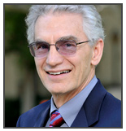
Cross-cultural workers carry their social values and expectations with them. When they establish new ministries they often find the role of the learner too slow and too difficult for their taste and insist upon transplanting the organization and values they have carried from their home communities. The more tightly they hold on to these social values, the more prone they are to idolatry, depending upon their systems, rather than fearing the Lord.
Sherwood Lingenfelter, Transforming Culture, 172

Slide 61
Toward a Practical Method for Developing a Christian Worldview in Any and Every Time and Place: Translation and Contextualization:
Tests of a Genuinely Contextualized Christianity:

Slide 62
Toward a Practical Method for Developing a Christian Worldview in Any and Every Time and Place: Translation and Contextualization:
Tests of a Genuinely Contextualized Christianity:
It does not compromise the gospel of Jesus Christ (Acts 17:31; 1 Corinthians 2:2; 15:1-5; Galatians 1:6-9).

Slide 63
Toward a Practical Method for Developing a Christian Worldview in Any and Every Time and Place: Translation and Contextualization:
Tests of a Genuinely Contextualized Christianity:
It makes the word of God a top priority (Hebrews 4:12; 2 Timothy 1:13-14; 2:1-2, 15; 3:16-17).

Slide 64
Toward a Practical Method for Developing a Christian Worldview in Any and Every Time and Place: Translation and Contextualization:
Tests of a Genuinely Contextualized Christianity:
It makes the word of God a top priority (Hebrews 4:12; 2 Timothy 1:13-14; 2:1-2, 15; 3:16-17).
Translation:

Slide 65
Toward a Practical Method for Developing a Christian Worldview in Any and Every Time and Place: Translation and Contextualization:
Tests of a Genuinely Contextualized Christianity:
It makes the word of God a top priority (Hebrews 4:12; 2 Timothy 1:13-14; 2:1-2, 15; 3:16-17).
Translation:
Proclamation:

Slide 66
Toward a Practical Method for Developing a Christian Worldview in Any and Every Time and Place: Translation and Contextualization:
Tests of a Genuinely Contextualized Christianity:
It makes the word of God a top priority (Hebrews 4:12; 2 Timothy 1:13-14; 2:1-2, 15; 3:16-17).
Translation:
Proclamation:
Inculcation:

Slide 67
Toward a Practical Method for Developing a Christian Worldview in Any and Every Time and Place: Translation and Contextualization:
Tests of a Genuinely Contextualized Christianity:
It is culturally expressed but distinctively Christian.

Slide 68
Toward a Practical Method for Developing a Christian Worldview in Any and Every Time and Place: Translation and Contextualization:
Tests of a Genuinely Contextualized Christianity:
It is culturally expressed but distinctively Christian.
It brings about noticeable and sustained transformation in the lives of its members (Philippians 1:6).

Slide 69
Conclusion:

Slide 70
Black

Slide 71
Worldview link at BibleStudyDownloads.org
Get this presentation for free!
Notes:
WV (Worldviews)

